Slide 1
The ARRL and You!
What the ARRL provides with your membership
de Ray Lajoie AA1SE WMA Section Manager

Slide 2
First one is easy!

Slide 3
Other Magazines Available:
- On the Air Magazine Geared toward the new ham
Optional to receive instead of QST
- NCJ National Contest Journal.
For the contester. News, scores, contest info, etc.
QEX For the radio and electronics experimenter.
Each magazine is available for download as a member free!
You choose QST or OTA as a print to be mailed, the other can be downloaded

Slide 4
LOTW!!!
Logbook of the world- Used by hams worldwide! Get confirmations for ARRL awards, contact management, etc.
Special note: LOTW has got a lot of bad press lately for system issues. They are aware of it. Patience is the best thing and they are looking at continuing improvements ongoing.
LOTW has a groups.Io reflector that will provide assistance if needed.

Slide 5
Advocacy!!!
The League works with the FCC and US and State Governments to protect our spectrum we use.
How can we protect it? BY BEING ON THE AIR!
We also work to ensure fair access for radio. Antenna restrictions, HOA’s etc. We don’t win every battle but the league may help at the local level.

Slide 6
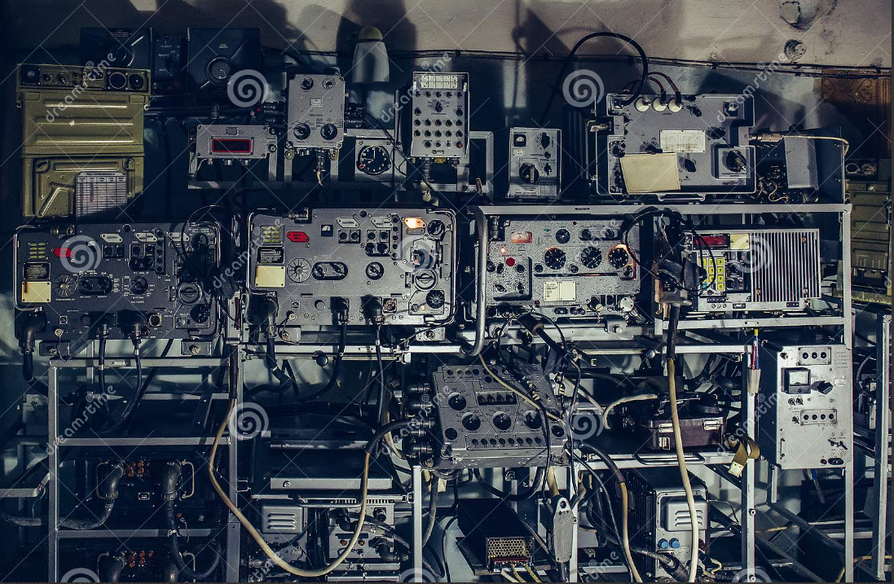
Tech information services
There is vast technical assistance available. From section field staff to league staff to assist in problems with radio’s, antenna’s setups, etc. Consult your club first, then to section TS’s, then to Headquarters. Depending on the issue, direct to ARRL if fine.

Slide 7
Product reviews
The ARRL does new product testing and publishes them in QST. Manufacturers also benefit from this also.
Tested items go on auction in October to benefit various league programs.

Slide 8
Lately…MONEY!!!
In 2022 the league has received 500,000 dollars from the ARDC and has provided grants to clubs to finance projects and programs. They hope this will continue in 2023.
The league also provides scholarships to students to help in continuing their education.

Slide 9
Outgoing QSL Service
For a small fee,(FAR less than the Post Office!) ARRL will take your QSL cards and distribute them around the world. They also receive them from countries and they are sorted and sent to you.

Slide 10
The Learning Center
TLC is an online service to provide education in many aspects of radio. It is free and available to members
A new addition coming soon will be for clubs to learn about specific functions. Ex. 501c3, fundraising, meetings, etc

Slide 11
Other goodies
You get an arrl.net email forwarding service
E-Newsletters for whatever interest you. Selectable in My Profile.
Listings for Clubs, License classes, Hamfests, Field Day Locator.
Affiliated clubs can get their own callsign.
Club Commission program.
Mailing address labels for your area. Once a year for free.
VE test processing and supply.
Hamfest assistance. Affiliated clubs are provided with gift certificates
Special Service Clubs.
I’m sure I have missed some. A call or email will always get assistance. Your Section Manager can help as well!

