Slide 1
The Reverse Beacon Network – Spots and More
Pete Smith, N4ZR and the RBN Team
For the Hamden County Radio Association, January 17, 2023

Slide 2
How It Began
Late 2008 - N4ZR helping VE3NEA with testing CW Skimmer alpha and beta
PY1NB (now CT7ANO) e-mail conversation with N4ZR
Felipe suggested the idea of using his Dxwatch web page software to display Skimmer spots.
Felipe wrote the first Aggregator
…and the rest is history

Slide 3
Who We Are
Felipe PY1NB/CT7ANO – Co-founder, website and server management
W3OA –Aggregators, server optimization
Dave KM3T– Relay Servers, general server-side expertise
Mark, K7JMG – Revision of web page, map
Nick, FM5VIH/SV3SJ – Spots Analysis Tool, server optimization
Pete, N4ZR – Co-founder, user support, publicity, RBN blog

Slide 4
The RBN in 2022
Users
Web Page
CW, RTTY, PSK ,FT8
“Retail” Clusters
200+ Skimmers Worldwide
Windows Aggregator Software At each node
DB/Web server
Telnet Server
3 Relay Servers

Slide 5
Milestones
2008 – CW Skimmer released and RBN begun as a web-based system..
2008-9 -- SDR-IQ and QS1R receivers introduced, providing multi-band coverage
2009 -- First RBN spots via “retail” DX clusters, W3OA’s first Aggregator (now version 6.3)
2010 – F5VIH/SV3SJ developed Spots Analysis Tool
2011-13 – Huge increase in spot volume and number of Skimmers
2019 – Added FT4/8 coverage
2021 – 11 million spots in CQWWCW – >60/second.
2022 – Who knows? – 13 million? SSB (JK)

Slide 6
What’s a Skimmer?
A volunteer operator – no experience required
A Software Defined Receiver – US$20-600
Receives bands, not individual frequencies
A multi-band antenna or antennas
CW and/or RTTY Skimmer Server software running on a Windows PC. Licenses are $75 and $50 from VE3NEA, 30-day free trial
Aggregator software – provided by the RBN free
A moderate-speed Internet connection

Slide 7
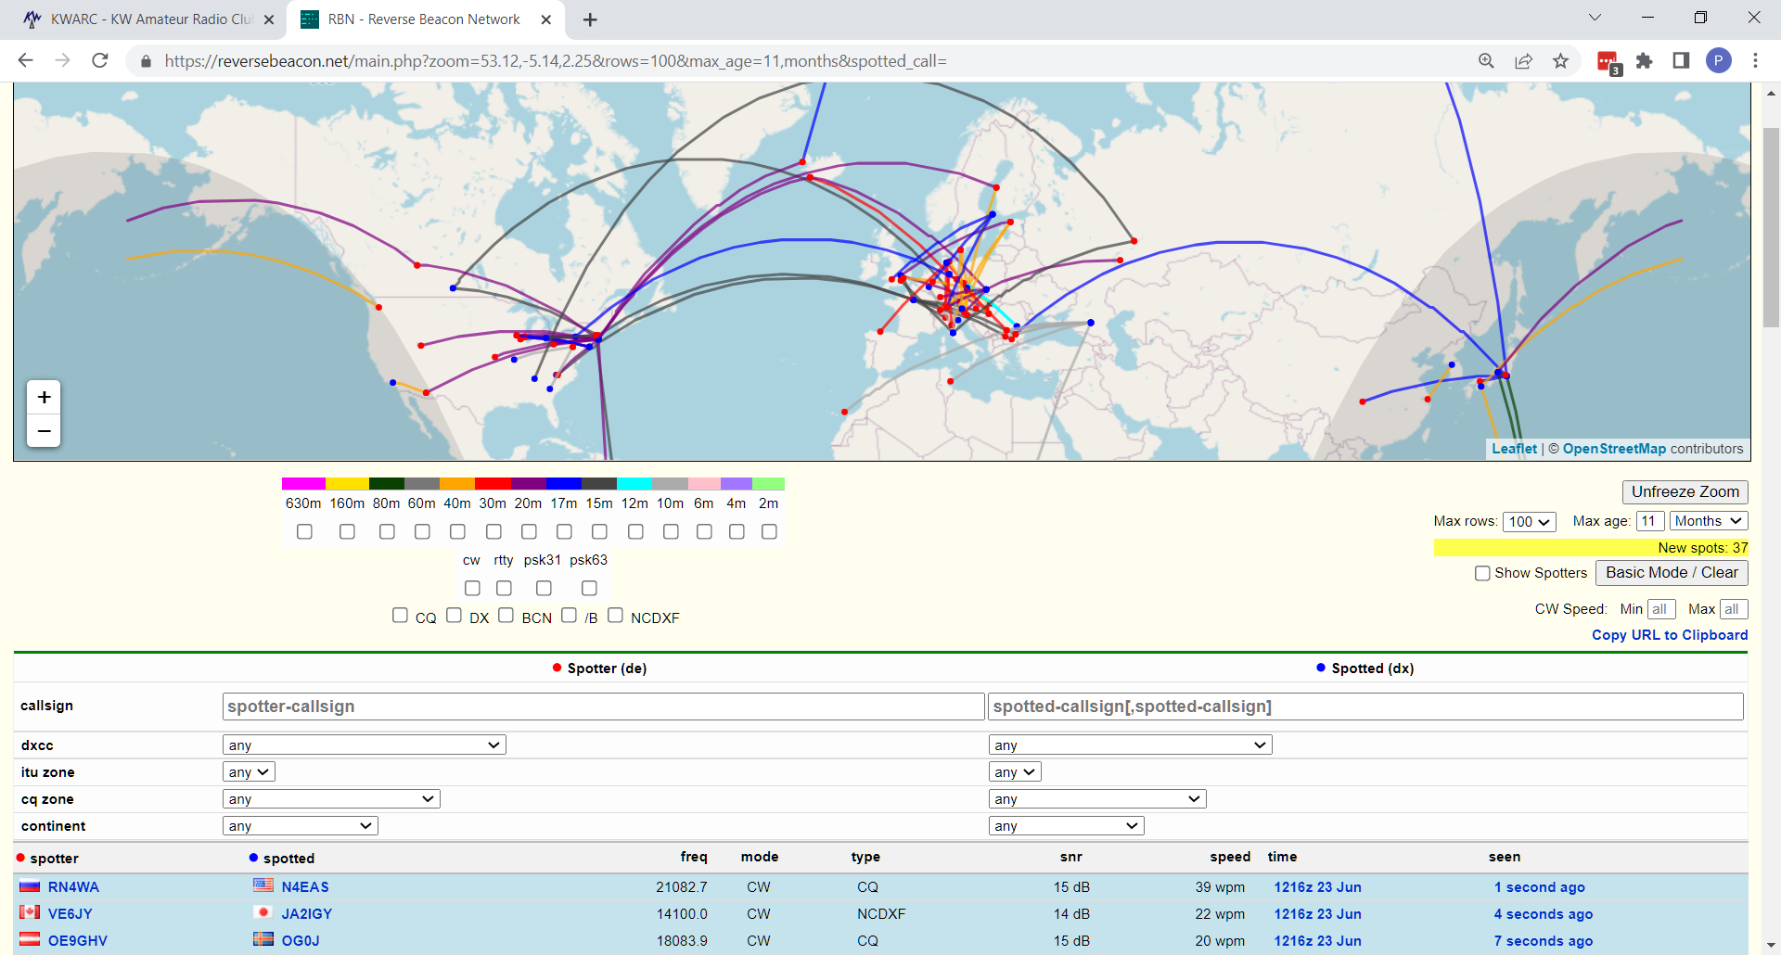
The RBN Web Site

Slide 8
What You Can See There
Spots as They Happen

Slide 9
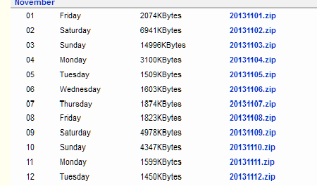
Archived Raw Data

Slide 10
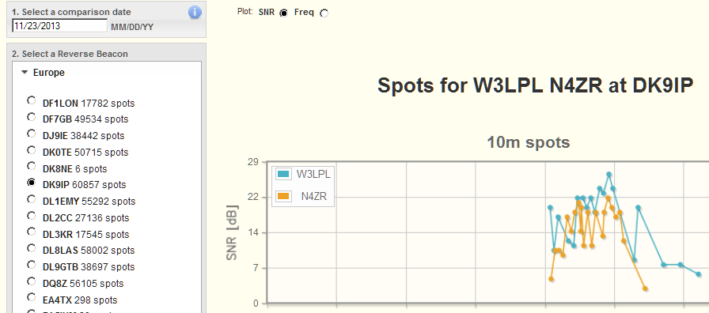
The Spots Analysis Tool

Slide 11
Pros and Cons of RBN Spots
100x as many spots as traditional spotting network
Everything spotted, not just those judged as “rare”
Duplicate spots (though not on CC Cluster)
Too many busted spots, despite 99% accuracy per Skimmer, because there are so many Skimmers

Slide 12
Using RBN Spots
Use filters that you set at “retail” DX cluster node or in client to feed logging software
Save favorite combinations
AR Cluster has extensive filtering options for RBN spots – CT1BOH quality filters really work!
CC Cluster does most filtering, dupe removal for you
Develop techniques for jumping spots quickly
Experiment!

Slide 13
Examples of Filtering
AR Cluster: set/dx/filter call=N4ZR or (not skimmer and spottercont=NA) or ((skimmer and unique>2) and (spotterstate=[WV,MD,VA,PA,NC]))
CCCluster: Use Client to set criteria and send to cluster

Slide 14
Antenna Tests
Send TEST or CQ twice, your call 2-3 times, and look for spots
QSY, change antennas, and TEST again

Slide 15
FT4/8 Coverage
Begun in 2019, after long debate
Biggest problem – sheer volume
The solution – make FT4/8 spots available via Telnet, but don’t archive or display on the website
Encourage “retail” clusters to carry FT4/8 spots

Slide 16
Status in 2023
Many clusters carrying RBN FT4/8 spots:
Partial list (no special order)
dxc.mx0nca.uk:7373 k9lc.ddns.net:7300 dx.w8bs.net:7300 ve3cgr.dyndns.org:7300 dxc.n4zkf.com:7373 k2can.us:7373 n6ws.ddns.net:7300 dxc.w9pa.net:7374 dxc.k0xm.net:7300
dxcluster.cronux.net:7300 (EA3CV)
cluster.zs2ez.org :7373
Huge volume – 95 percent of total spots now FT4/8

Slide 17
Resources
RBN website – http://reversebeacon.net
On the website: 7 bands of CW and At Least 13 bands of FT4/8 on a Single Red Pitaya
RBN blog – http://reversebeacon.blogspot.com
Tutorial - http://reversebeacon.blogspot.com/2013/12/a-new-tutorial-on-using-rbn.html
Download of Aggregator – on the RBN web site
ARCluster filters – http://www.k3lr.com/w9zrx/Using%20AR-Cluster%20V6.pdf
CCUser - http://www.bcdxc.org/ve7cc/default.htm#prog
Mailing lists:
skimmertalk@contesting.com
RBN-OPS@groups.io
hamsci@groups.io
That’s all folks!

