Slide 1
HCRA Introduction To Contesting
Let’s Make Contesting Fun!

Slide 2
Your Instructors
Jeffrey Bail - NT1K - Main Interest In Amateur Radio is contesting. First “contest” was Field Day in 1995. Mostly active during contests, Field Day and DXpeds. Part of multi operator, multi radio events.
Matt Wilhelm - W1MSW - Was introduced to contesting by Jim - KK1W & Frandy - N1FJ (it’s their fault) after moving to the area and finding HCRA. Very active in HF contesting, especially in the “Big 4”. Past national and division category winner in ARRL DX CW using modest home station.

Slide 3
Class Goals
Introduction to Contesting
Understanding what contesting is
Choosing the correct contest
Understanding rules and guidelines of the contest
Software Choices
Propagation
Getting ready
Log Submission, Scoring and Contest Awards
Improving your score
Your Station
Tips and Tricks
Additional Hardware
Do’s and Don’ts
N1MM Logger+ Overview

Slide 4
What is contesting?
It’s an event where an operator or a team of operators compete by establishing contact with many operators in a given period of time while exchanging a piece of information.
Most contests are sponsored by an organization, club, group or individual. They are responsible for creating and defining the rules, entry categories, multipliers, and log checking and issuing the awards.

Slide 5
Why Contesting?
Competitive
Keeps your station updated/working
Makes you a better operator
Obtain awards faster (DXCC, WAS)
Makes it easier dealing with QRM, QRN
Great camaraderie with other contesters
More wallpaper
Useful in other areas (EmComm, Nets)
It’s Fun!
Notes:
1 Weekend DXCC

Slide 6
Some Facts About Contesting
There are over 550 contests per year.
Even with similarities, almost each one is unique (Mode, Band, Time, Category)
Some are more popular than others (CQ WW, ARRL DX, WAE, All Asian)
State QSO Parties is a great way to start in contesting
World Radiosport Team Championship is considered to be the “Olympics” of amateur radio. For 2018, contestants are chosen based on their scores from 12-16 contests during 2015 and 12-16 contests during 2016.
Contests can last from just a couple hours to over 48 hours

Slide 7
Contesting Myths
You need acres of aluminum
You need to pre-register
You need to pay to play
You have to have the best, most expensive transceivers
You must have at least two radios (SO2R)
You have to be a member of a contesting group or club.
If you operate as a member of a club, you can’t also compete as an individual
You have to be on the air for the entire event

Slide 8
Different Types of Contests
Sprint
Mode specific (SSB only, CW only, RTTY only)
Band specific (ARRL 10m)
Part time (NEQP)
Full time (48hr, CQWW)
QSO Parties
Country/Area Specific
Field Day (US)
Mixture of the above

Slide 9
Some of Terms and Lingo Used In Contesting
S&P - Search and Pounce
Running - Calling CQ
Q - Contact (QSO)
Rate (Q Rate) - Contacts Per Hour
NIL - Not in log
Multiplier - Contact with station will multiply your score (more about that later)
Dupe - Duplicate contact
Cluster / Skimmer (Assisted) - Using the internet to find stations
Big Gun - Big station optimized for contesting (K1TTT, K3LR, K9CT)
Little Pistol - Single operator stations
Cut numbers - In CW, numbers are replaced with letter to shorten the contact
Busted Call - Callsign you incorrectly copied

Slide 10
What equipment do I need for contesting?
Minimal setup consists of
Transceiver
Antenna
Logging (paper or computer logging)
Preferred setup consists of
Transceiver with filtering
Directional antenna, multiple antennas, receive antennas
Hands free microphone, Automated keyer and Digital Voice Keyer
Computer with serial in/out (and/or USB) for radio control
Contest grade logging software (N1MM, Wintest, N3FJP)
Make due with what you have! It doesn’t have to cost more money to contest. We will go in more detail about setting up your station for contesting later.

Slide 11
How do I start contesting?
Start by looking at what’s coming up.
WA7BNM’s Contest Calendar
SM3CER Contest Service
QST’s contest corral (www.arrl.org/contest-calendar)
Sponsors website directly (NEQP.org, ARRL.org, CQWW.org)
Last resort… Google.com
We will be using WA7BNM’s Contest Calendar in this course http://www.hornucopia.com/contestcal/

Slide 12
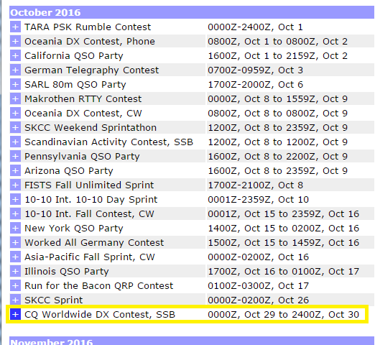
Picking the contest
Using WA7BNM’s online calendar sorted by Perpetual month. Look at what appears to be interesting to you. Use a search engine to see how popular that contest is
We’ll focus on the CQ World Wide DX Contest (SSB) as it’s a popular (biggest) SSB contest and unofficially kicks off the contest season. Qualifier for WRTC
For 2016, It starts at 0000z (8pm local) on Friday, October 28th until Sunday, October 30th at 2400z (8pm local)
Press the blue + symbol for more information

Slide 13
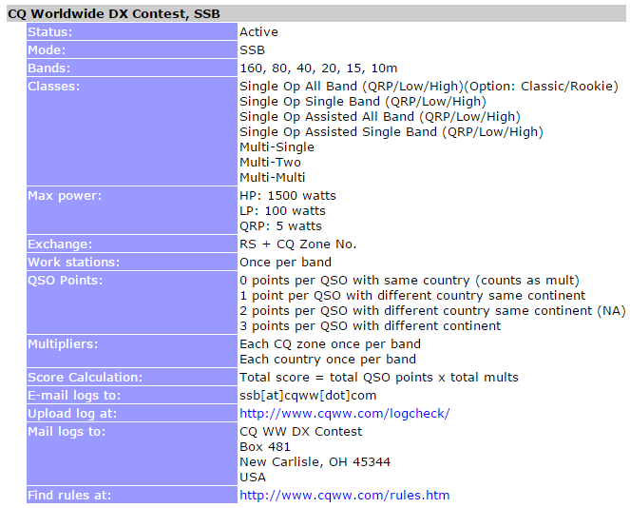
Learning about the contest
Based off the information given in the calendar, you can technically operate in the contest without visiting the sponsor’s website. However it’s important to read and understand the rules and guidelines of each contest
The entry should link to the sponsor (CQWW) and the rules of the contest
Also lists the exchange needed to complete the contact.
If you hear a contest but you are not sure which one it is, you can use the calendar and find out by the date, frequencies, calls and exchange being used.

Slide 14
Learning about the contest
Status: Active - Contest is still on
Mode(s): SSB - Contesting will be using SSB only. Some contests are multimode that use SSB and CW or SSB, CW and Digi.
Bands(s): 160, 80, 40, 20, 15, 10m used during the contest. Some contests are band specific (ARRL 10m) or some contests are limited to a couple bands. Notice no WARC bands. In most contests, 60, 30, 17 and 12m are off limits

Slide 15
Learning about the contest
Classes: AKA Category. This is how you are entering in the contest.
SOAB - Single Op, All bands
SOSB - Single Op, Single Band
SOAB/A - Single Op, All Band, Assisted
SOSB/A - Single Op, Single Band, Assisted
M/S - Multiple Ops, Single Radio
M/2 - Multiple Ops, 2 Radios
M/M - Multiple Ops, Multiple Radios
There are different power categories as well (QRP, LP, HP) and some contest have special overlays (portable, emergency power, wires only, T/B wires)
Common example, SOAB LP or SOAB/A LP if you want to use the spotting network/cluster

Slide 16
Learning about the contest
Max power: Some contests limit you to a power level or there may be different categories such as Low Power (LP, 100w or less [ARRL <150w]), High Power (HP, >100w[ARRL <150w]) and QRP (5w or less).
Exchange: The piece of information you exchange with the other operators. Very important to know before attempting to make a contact. The exchange will vary depending on the contest. Easy as RS/RST and CQ Zone for CQWW to difficult as Serial. Precedence, Callsign, check and ARRL section for the ARRL Sweepstakes. Sponsor will use the exchange along with the callsign and time to cross check for points.

Slide 17
Learning about the contest
Work Stations: Once per band - Telling you that you can only work that station ONCE on each band. Some contests allow multiple contacts per band if the other station is mobile/rover (Sweeps = 1 per contest)
QSO Points: This is how your contacts are scored. Once again this varies depending on the contest. For CQWW SSB 2016, it’s the following
0 points per QSO with someone in the same country (unless you need mult)
1 point per QSO with station in a different country but on the same continent (EU to EU)
2 points per QSO with different country in same continent in North America (US to CA)
3 points per QSO with different continent (US to country outside of North America, DL)
Notes:
Discuss mults on next slide

Slide 18
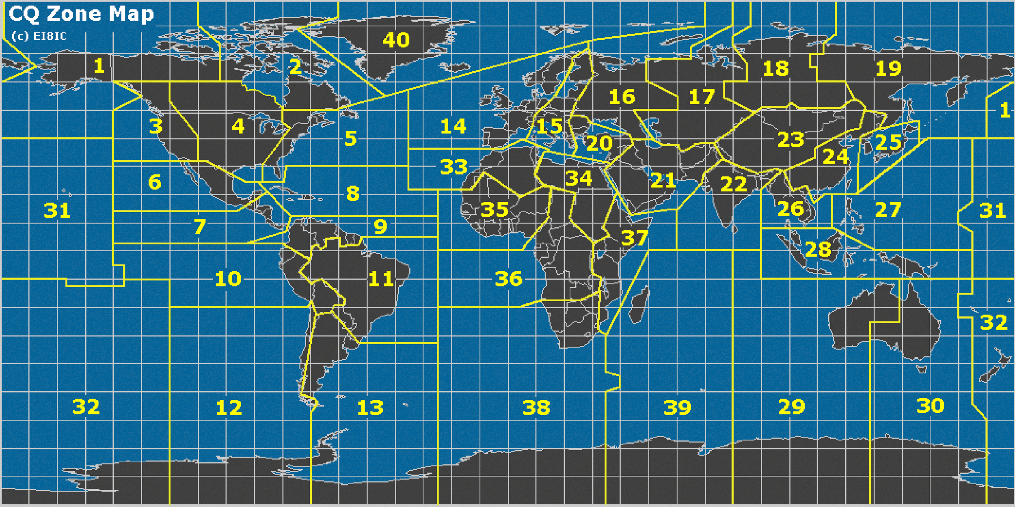
Learning about the contest - Multipliers
Multipliers: You can multiply your score by making contact with certain stations. This varies depending on the contest. Examples can be counties, states, ARRL section, CQ Zone, ITU Zone, Country, Province and many others. Some contests have more than one multiplier. For CQWW SSB, they have two multipliers that include CQ Zone and Country.

Slide 19
Learning about the contest - Multipliers/Score Total
For example, you made your first contact with a german station, you will get 3 points for the contact in CQWW SSB. Since Germany is a new country, You can multiply your entire score by 1. Since Germany is in Zone 14, you can multiply your score again by 1. If your next contact is with a French station, you can now multiply your score by 2 but since France is in Zone 14, you will not be able to get a double mult.
At the end of the contest, you would add up your points, multiply it by the total amount of unique countries per band added with the total amount of unique CQ Zones per band. This is where contesting software would come in handy

Slide 20
Learning about the contest
E-mail log information : Most contest sponsors want cabrillo format for log, most contest software will export to cabrillo
Upload log at: Some contests will allow the user to upload their log instead of sending it VIA e-mail.
Mail logs to: Some contests will allow the user to send in their logs if they decide to use paper logs.
As you see the CQWW SSB contest allows multiple ways to send in your logs. There are many contests that will only accept logs VIA e-mail.
If you don’t submit a log, you could lose out on awards
Notes:
Show example text file of Carbillo format

Slide 21
Learning about the contest
Find Rules At: (Website, Document)
This is the most important part of this entry. It is very important to read and understand the rules in its entirety before jumping into any contest. Failure to read and understand the sponsor's rules could land you into trouble with the sponsor and/or other operators
Let’s click on the link to the rules for CQWW 2016 http://www.cqww.com/rules.htm
You will see why it’s important. There is a lot of information that will not be listed on this calendar entry. Rules could change throughout the years.

Slide 22
Major Contests
CQWW DX SSB CQWW DX CW CQWW WPX SSB CQWW WPX CW IARU HF Championship - Multimode ARRL Intl DX SSB ARRL Intl DX CW WAE DX SSB WAE DX CW All Asian DX SSB All Asian DX CW

Slide 23
Notable Contests (For HCRA members)
State QSO Parties / NEQP ARRL 10m - Dec - HCRA participates as a club ARRL Sweepstakes ARRL Field Day NAQP SSB WPX RTTY VHF/UHF FM Sprint

Slide 24
Contest Logging Software
Suggest to use software dedicated for contesting
General logging software (HRD, DXlabs) lacks options even though they may have a “contest mode” built into the software
Most popular contesting software are N1MM Logger+, Wintest, N3FJP (US), Writelog, Skookum (OSX) among others.
There are linux logging software. Most use N1MM+ using WINE
Computer doesn’t have to be “the latest and greatest” but a decent processor/ram will help out with DB entry and some automation (keyer)
For this course, we will be referencing and learning using N1MM Logger+

Slide 25
Propagation
Is the study of how radio waves travel from point A to B or into the atmosphere
Affected by vapor in troposphere and ionization due to solar activity
Can be predicted based off solar information and past history
Contesters use predictions as a tool
Various software and websites can be used
These tools will give you an idea. Even more useful if you’re un-assisted. Use it as a suggestion
Allows for you to be on the correct band at the correct time.
VOAcap (Voice Of America) is most popular website/software
Let’s visit VOACAP online and try it out http://www.voacap.com/

Slide 26
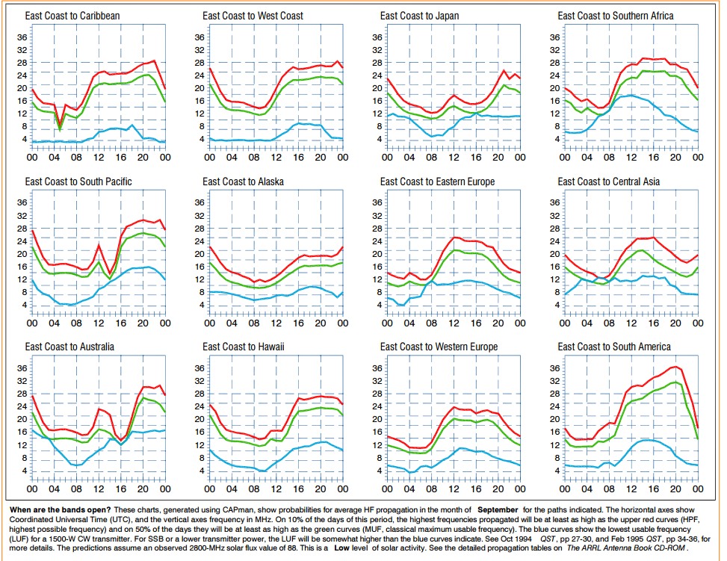
Other Propagation Prediction Sources
ARRL Charts
N0NBH - Seen on most sites
NW7US (HFradio.org
HFpropagation.com (real time)
N6BV’s Charts/Site
K6TU Site ($ 30yr)

Slide 27
Contest Preparation
Make sure everything's working days or weeks (not hours) before the contest
Loved ones know you won’t be available?
Antennas are working?
Software/hardware working?
Radio working? (Audio, power, rig interface)
Propagation working?
Everything you need during the contest ready to go?

